Slide 1
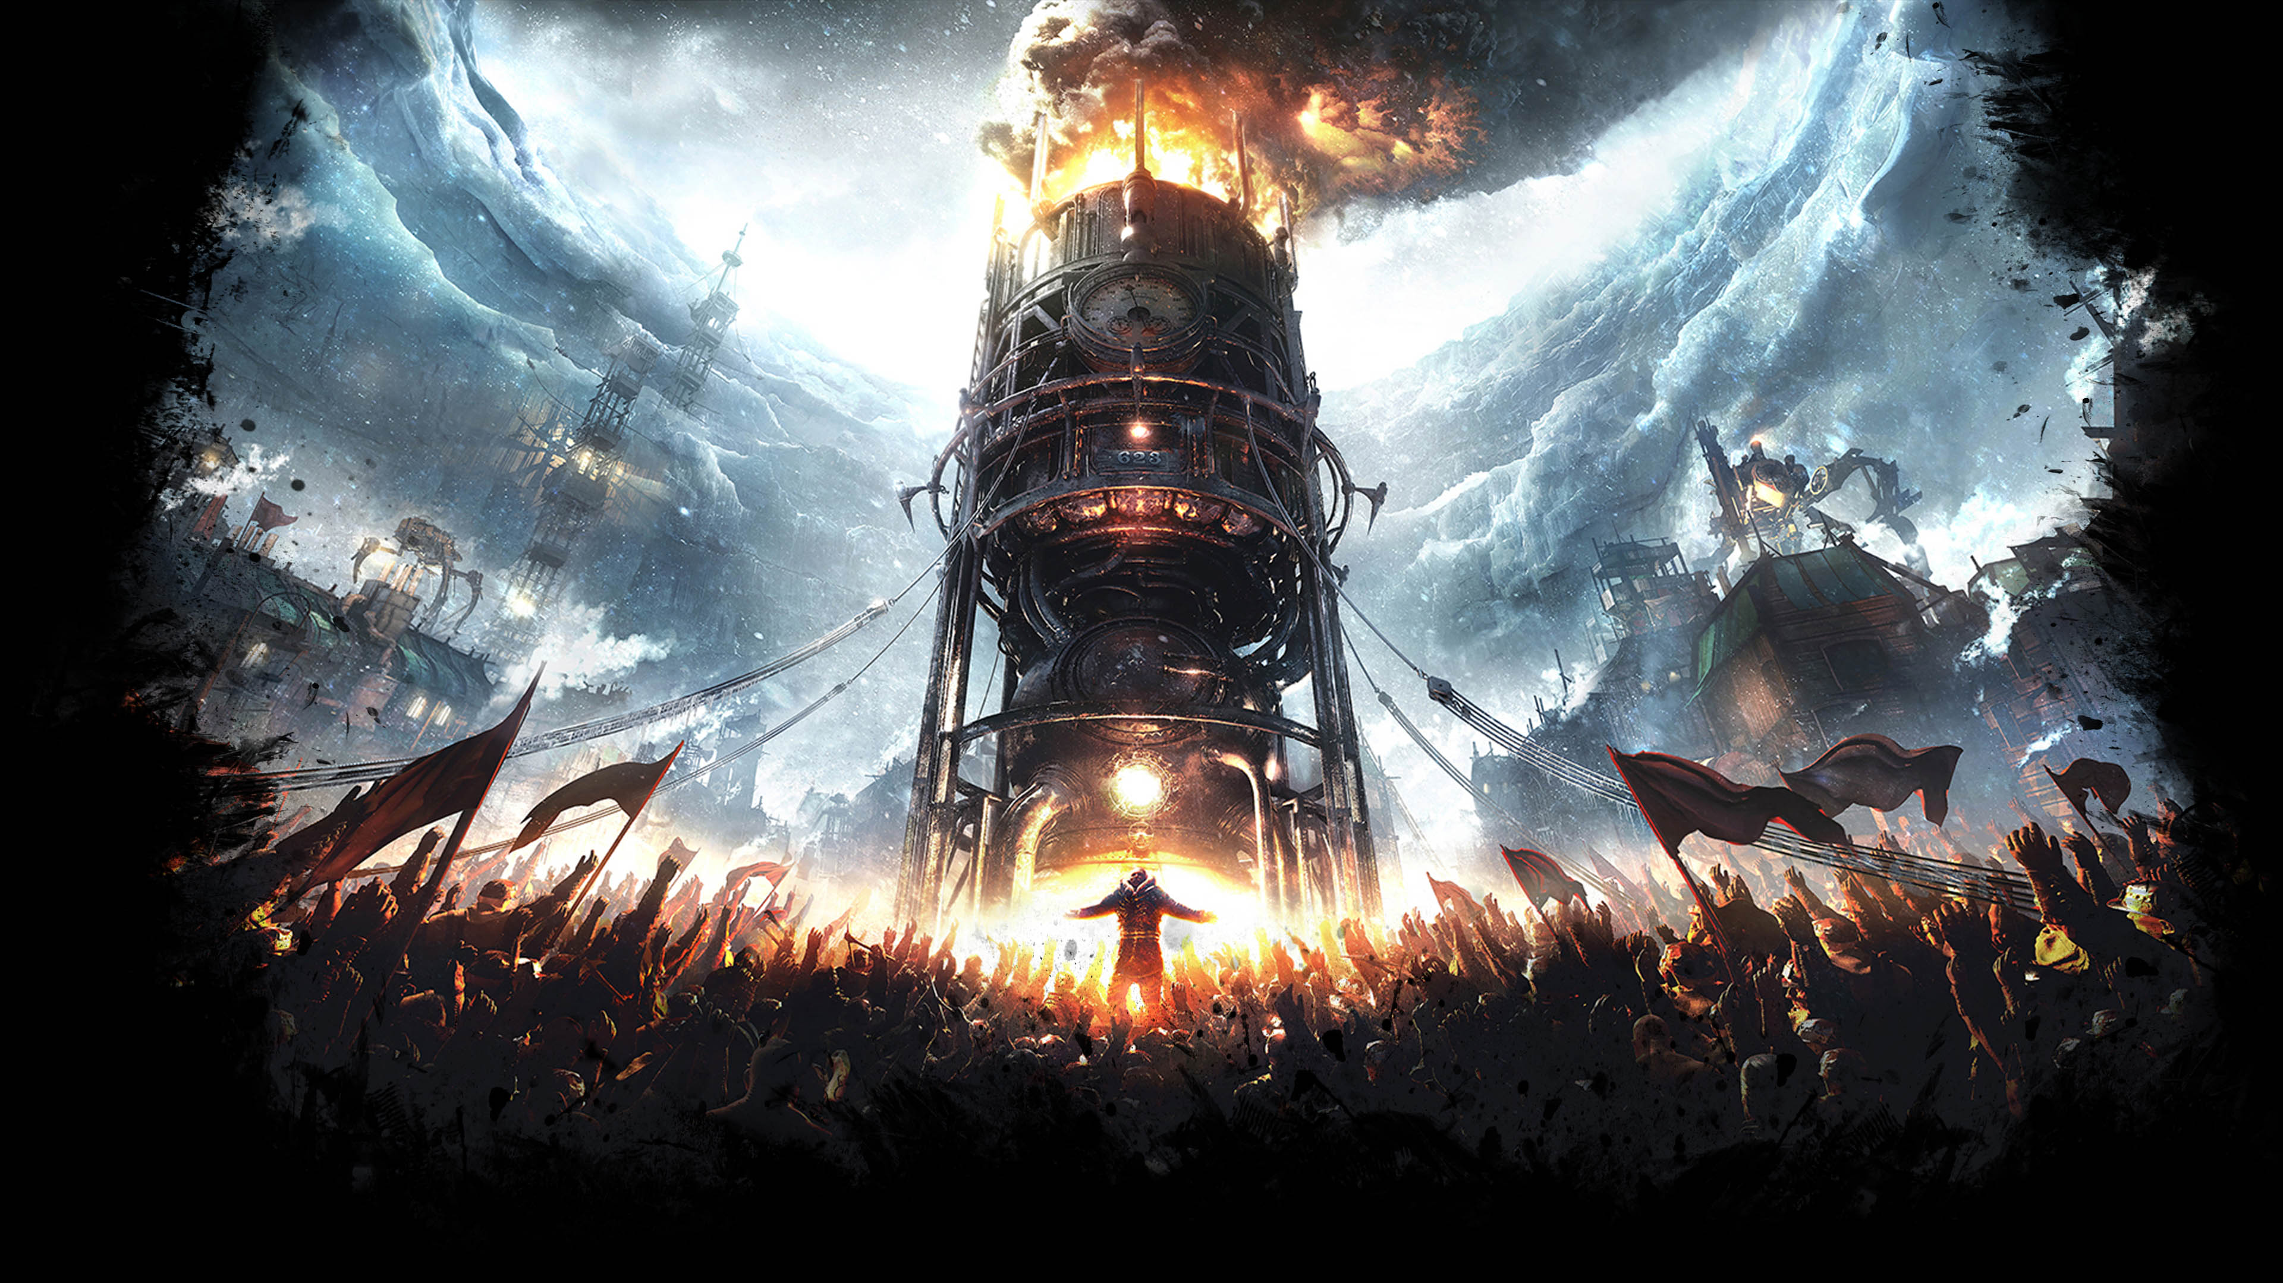
Frostpunk Laws
And why I love them

Slide 2
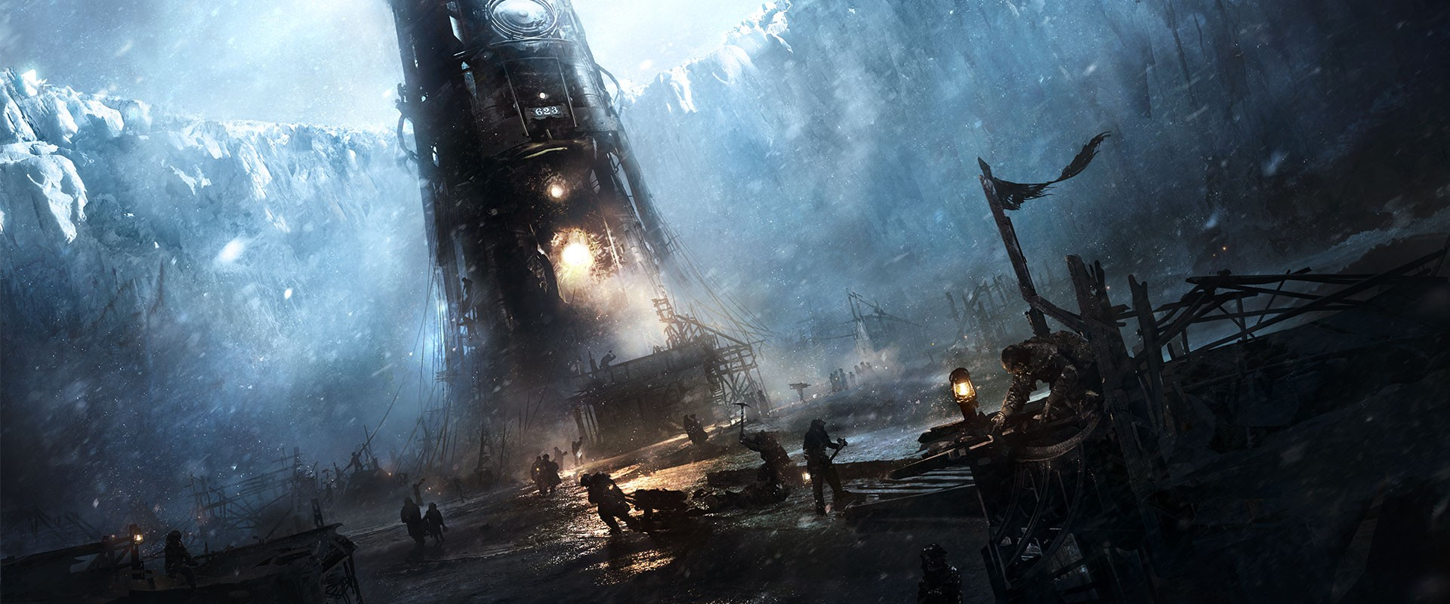
Adaption
Sawdust
Child Labour
Corpse Disposal
Extended shift
Dueling laws
Hidden bonus, Cannibalism!
More food, excellent
More workforce
Why need funerals?
10 hour work days, how nice
Get Stabbed, suckers
People die from hunger -> become food

Slide 3

Purpose
New Faith
Order
Public Penance (get whipped)
Become a Cult
Usually don’t go full cult, too bothersome
Propaganda Center
Become a Dictatorship
Same with Dictatorship

Slide 4
